Slide 1


Université des Mascareignes BA (HONS) Digital Humanities Specialisation Tech Start-Up
Module: Culture of Innovation and Entrepreneurship
Project Name:
Mom’s Touch Home-made Food
22 December 2023

Slide 2



Université des Mascareignes BA (HONS) Digital Humanities Specialisation Tech Start-Up
Module: Culture of Innovation and Entrepreneurship
# | Our Team Members | University | Email Address
1. | Naasir Ali Sundhoo | UDM | nasundhoo@student.udm.ac.mu
2. | Eswaree Chellygadoo | UDM | eechellygadoo@student.udm.ac.mu
3. | Kossi David Adekplovi | UDM | kdadekplovi@student.udm.ac.mu
4. | Anusha Ramanah | UDM | aaramanah@student.udm.ac.mu

Slide 3

Acronym: HOME - Home Of Mom’s food for Everyone
Main Objectives: Preparation, Cooking, Packing and Delivery of the most Healthiest and Hygienic Home-Made Food.
Business Activities/ Operations:
Prepare, cook, pack and deliver healthiest and hygienic home-made food on a daily basis to all those working at Ebene, Cyber-city, being our Short Term Strategy.

Slide 4

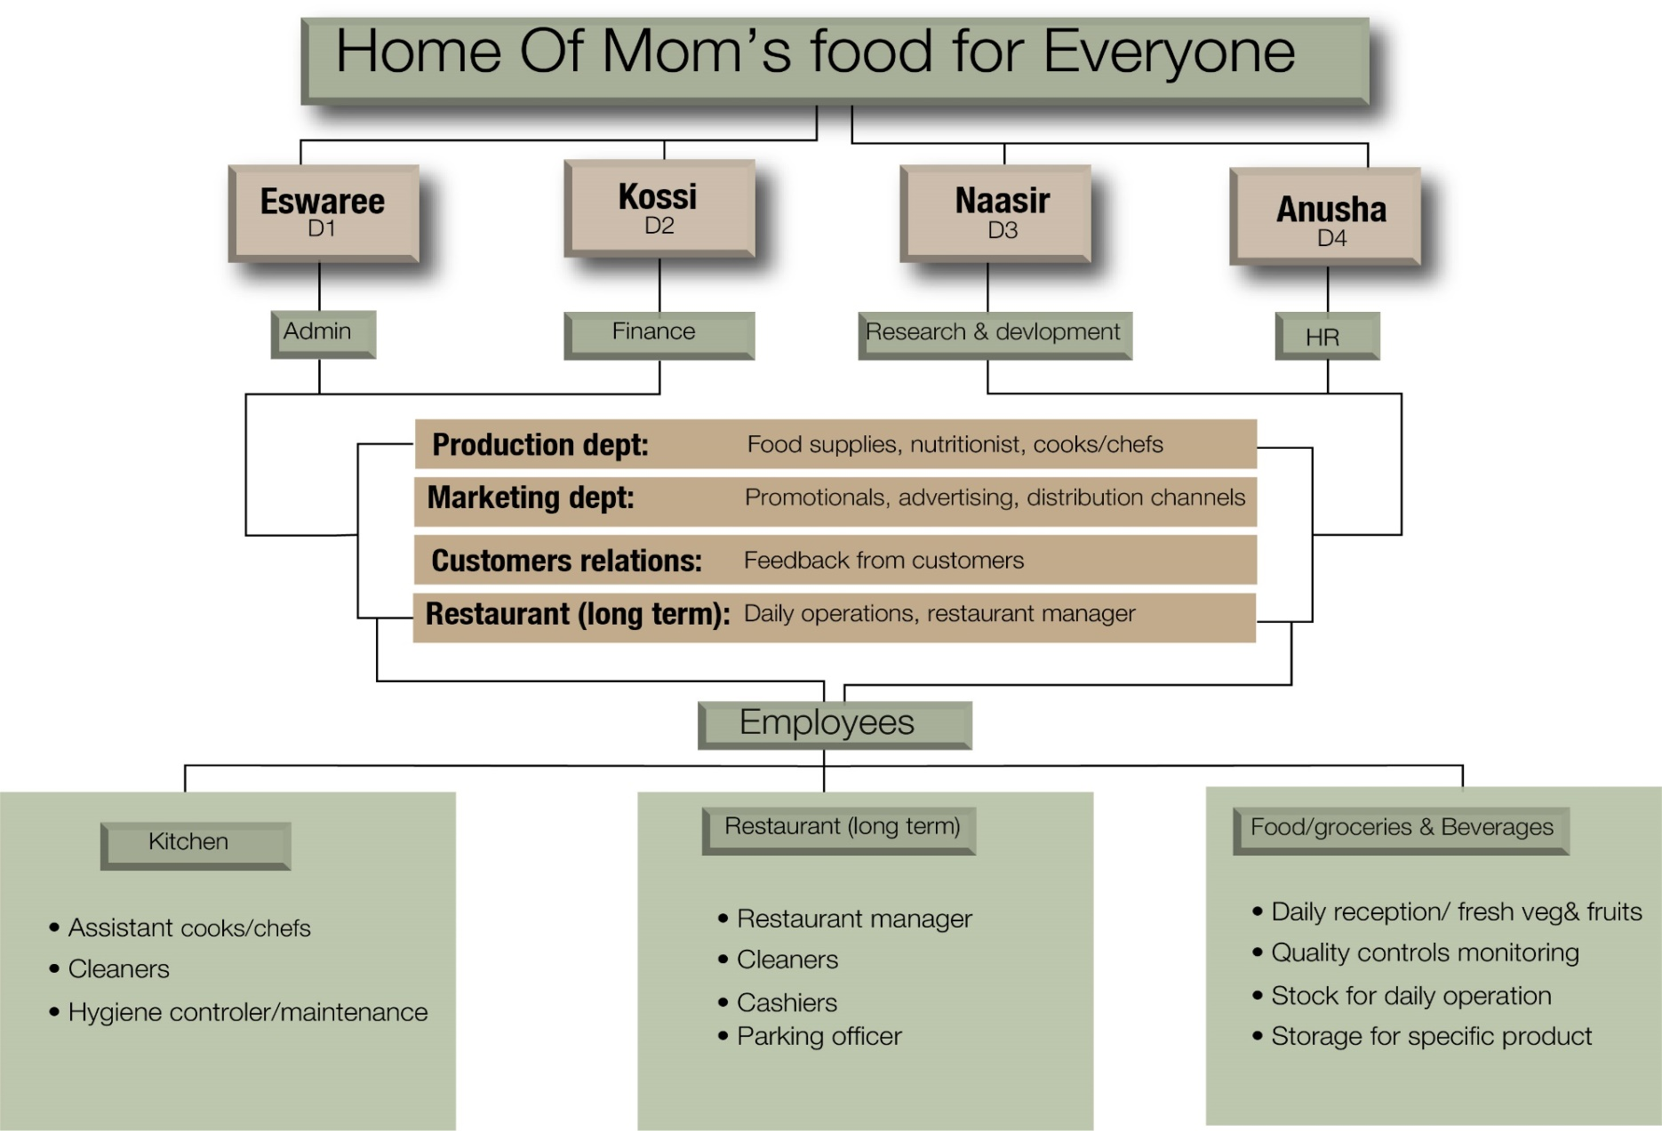

Our Organisation Chart

Slide 5
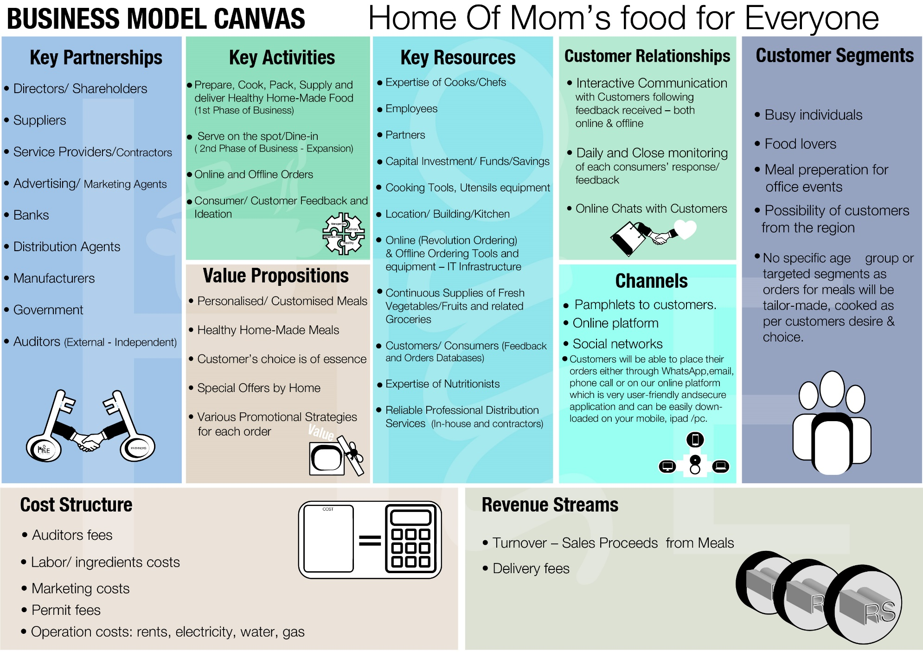

Slide 6

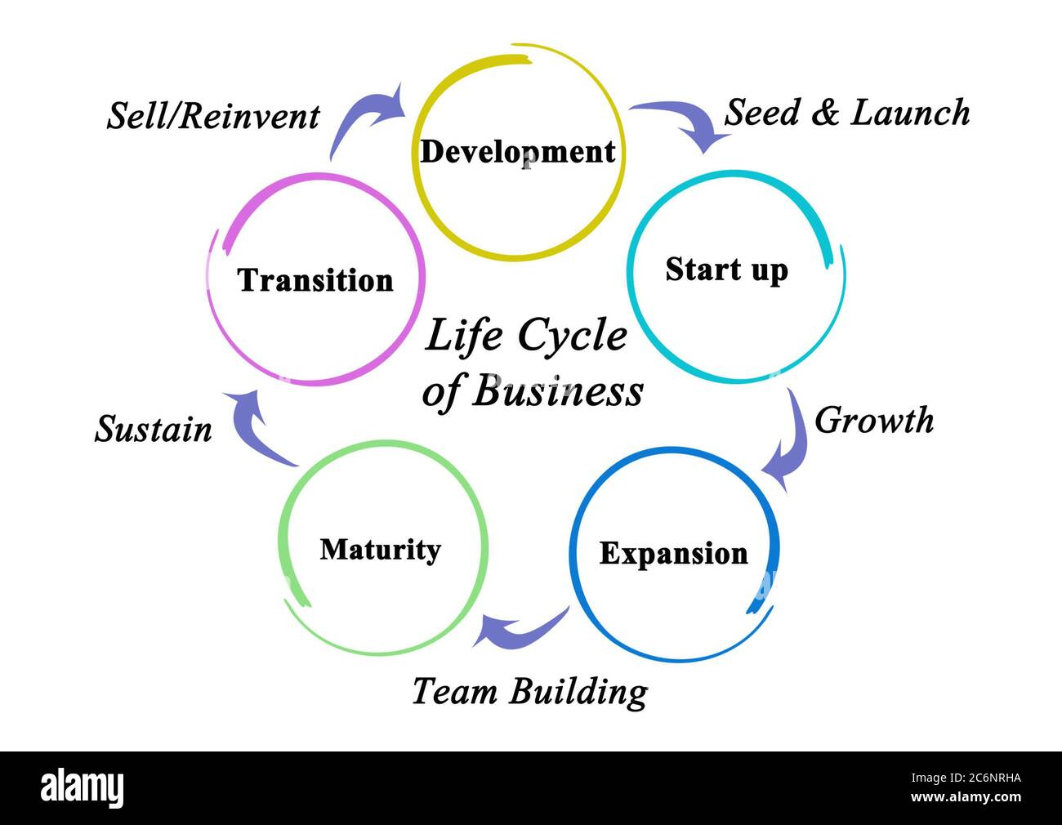
Our Business Life Cycle

Slide 7
SWOT Analysis – Strengths & Weaknesses
Strengths: Self-Employed – Own Boss Support & contribution of Family & Friends & Relatives (Motivational factor) – Family type business Expertise and Experience of Cooking/Mom’s Touch Home-made Food with Care Customer satisfaction and feedback Cleanliness/Hygienic cooking conditions Strict compliance to Food Regulations & Health & Safety Act Close monitoring of daily operations up to delivery to customers Own savings invested no bad debts No rental costs as food will be cooked/ prepared at home. Well-organised and disciplined procedures for daily operations. Just-in time/ Timely delivery | Weaknesses: Increase in operational costs – losses at the initial state Overflowing of orders at short deadlines – delay in deliveries Increase in workload Risk of omitting orders – customer dissatisfaction Quality of food might be affected in case of too many orders at short notices.

Slide 8
SWOT Analysis – Opportunities & Threats
Opportunities: Increase target customers Business Expansion while ensuring and maintaining quality of food and service New/More suppliers/sources for primary products such fresh vegetables, fruits & other groceries – imports Discounted prices for bulk purchase. Grants from Government to Small and Medium Enterprises Loan Facilities at very low interest rates Diversify meals/dishes as per customers’ choice – personalized orders Increase in the number of employees Brand Identity in the market 24/7 Food supply at the customer’s doorstep | Threats: Increase in Competitors on the market Unexpected increase in prices of vegetables & fruits following natural calamities/diseases in suppliers’ country New Government policies/regulations – impose embargos on imports/exports New fiscal policies by financial institutions in force – sudden increase in interest rates

Slide 9

Overview of Our Strengths & Opportunities (Short & Long Term strategies):
Own expertise of Mauritian and other Home-made Food – home cooking
Already own a Business Registration Card and Food Handlers Certificate
No rental costs as food will be prepared and packed at home – Family business type
Funds: personal savings
Delivery: Own means of transport – food carrying/cargo van
Family support and friends as main backbone for advertising (grapevine communication)
Extend supply and delivery channels to nearby regions, other institutions.
Adopt new strategies for food supply, special promotional prices on special religious events/ combo meals or packages on Fridays (Happy Hours), personalized orders or home delivery on special occasions.
New dishes, other than Mauritian Foods, special diet food, etc...

Slide 10
Overview of Our Weaknesses & Threats (Short & Long Run):
Initial investment: In case of business failure, the amount invested cannot be recovered.
Capital tied up in stock of goods and kitchen utensils including take-away and other packing materials.
Continuous increase in prices of vegetables and groceries.
High Competition/ Rivalry
Taxes imposed by the Government
New Strict Food Legislations in force

Slide 11
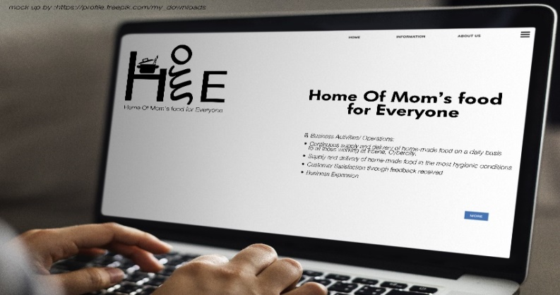
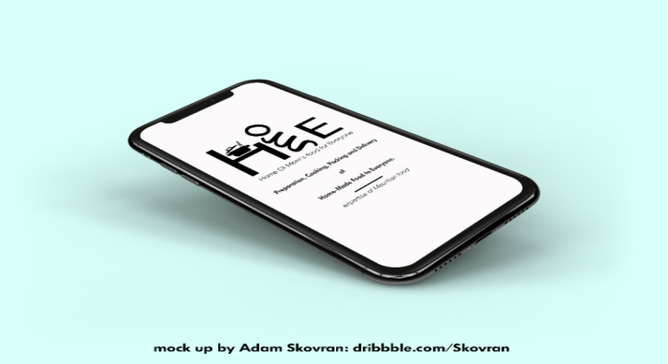
Operational Activities of HOME
As market penetration strategy, Home will begin its business activities by distributing pamphlets to the working population in Ebene at specific location namely bus-stops, Ebene shopping mall, reception desks of offices.
Customers will be able to place their orders either through WhatsApp, email, phone call or on our online platform which is very user-friendly and secure application and can be easily downloaded on your mobile, ipad or pc.

Slide 12
Revolution Ordering
HOME’s online application will be an easy interface for both mobile and web platforms, allowing users to easily find their dishes.
This application will show a list of menus, cuisines, ratings and reviews, allowing the customers to search-based on their choice.
Customers can create personalized profiles/accounts which will store their favorite meals and previous orders and can easily view their order history which will allow them to sort out their favorite meals with just a few taps.
The application will also offer real-time order tracking, allowing the clients to monitor their orders from its location to delivery.
Most importantly, the app will offer secure payment options, both cash and cashless such as cards, digital wallets and cash on delivery for appropriate and secure transactions.
The clients can give ratings and reviews for the dishes and services.
We can target the audience via social media and pamphlets to customers.

Slide 13
Value Proposition & Customer Segments: It is essential to understand who our target customers are and how our value proposition directly speaks to their needs.
For examples, various specialized/personalized meals are available:
1. For families looking for a great dining experience: “Enjoy quality food and attentive service in a relaxing atmosphere, perfect for family gatherings and celebrations.” (Strategic/Long Term Plans - Following Business Expansion – Opportunities -Restaurant)
2. For those seeking fast yet healthy meals: “Experience grab-and-go meals made from fresh, locally sourced, healthy, and delicious ingredients.”
3. For foodies seeking innovative flavors: “Discover exciting new dishes from around the world crafted with passion by our expert chefs.”
4. For those looking for a unique dining experience: “Experience a one-of-a-kind dining experience with interactive activities, live entertainment, and unforgettable ambiance.” (Strategic/Long Term Plans - Following Business Expansion – Opportunities - Restaurant)
5. For those with special dietary requirements: “Enjoy meals tailored to meet your specific dietary needs, made from the freshest ingredients and prepared to perfection.”

Slide 14
6. For food lovers looking for an adventurous culinary journey: “Explore a unique menu of traditional and modern interpretations of classic dishes from around the world, served with flair and passion by our experienced chefs.”
7. For those seeking upscale dining: “Indulge in delectable cuisine prepared with fresh, seasonal ingredients and served with impeccable attention to detail in an elegant setting. (Strategic/Long Term Plans - Following Business Expansion – Opportunities - Restaurant)
8. For those wanting a casual atmosphere: “Relax in our comfortable environment while enjoying a delicious meal and the company of friends over drinks or coffee.” (Strategic/Long Term Plans - Following Business Expansion – Opportunities - Restaurant)
9. For cost-conscious diners: “Experience quality meals without breaking your budget at our affordable prices – great value for a great dining experience.” (Strategic/Long Term Plans - Following Business Expansion – Opportunities - Restaurant)

Slide 15
10. For health-conscious diners: “Enjoy delicious and nutritious dishes prepared with fresh ingredients, providing you with the fuel you need to stay fit and healthy.”
11. For those seeking convenience and speed: “Grab a quick bite at our convenient location – fast service that doesn't sacrifice taste or quality.” (Strategic/Long Term Plans - Following Business Expansion – Opportunities - Restaurant)
12. For those wanting to support local businesses: “Support your community by enjoying delicious meals sourced from local farmers and suppliers – freshly prepared just for you!”
13. For those looking for a unique drinks menu: “Sip on craft cocktail drinks, international wines, and more – perfect for any occasion or celebration.”(Strategic/Long Term Plans - Following Business Expansion – Opportunities - Restaurant)

Slide 16


Thank You
For Your Attention

